Slide 1

London Frolics
Dom, Lydia, Allegra and Cynthujaa

Slide 2
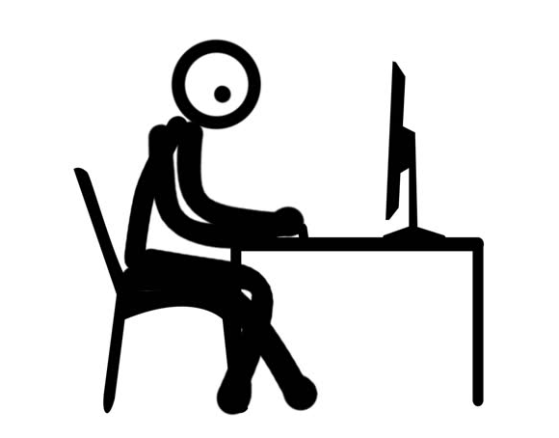
User Stories
Drafted user stories based on four types of users:
Blogger
Administrator
Subscriber
Reader
As a Blogger, I want to add posts so I can share my experiences with others.
Notes:
MOSCOW to prioritise the functionalities to design MVC model / database

Slide 3
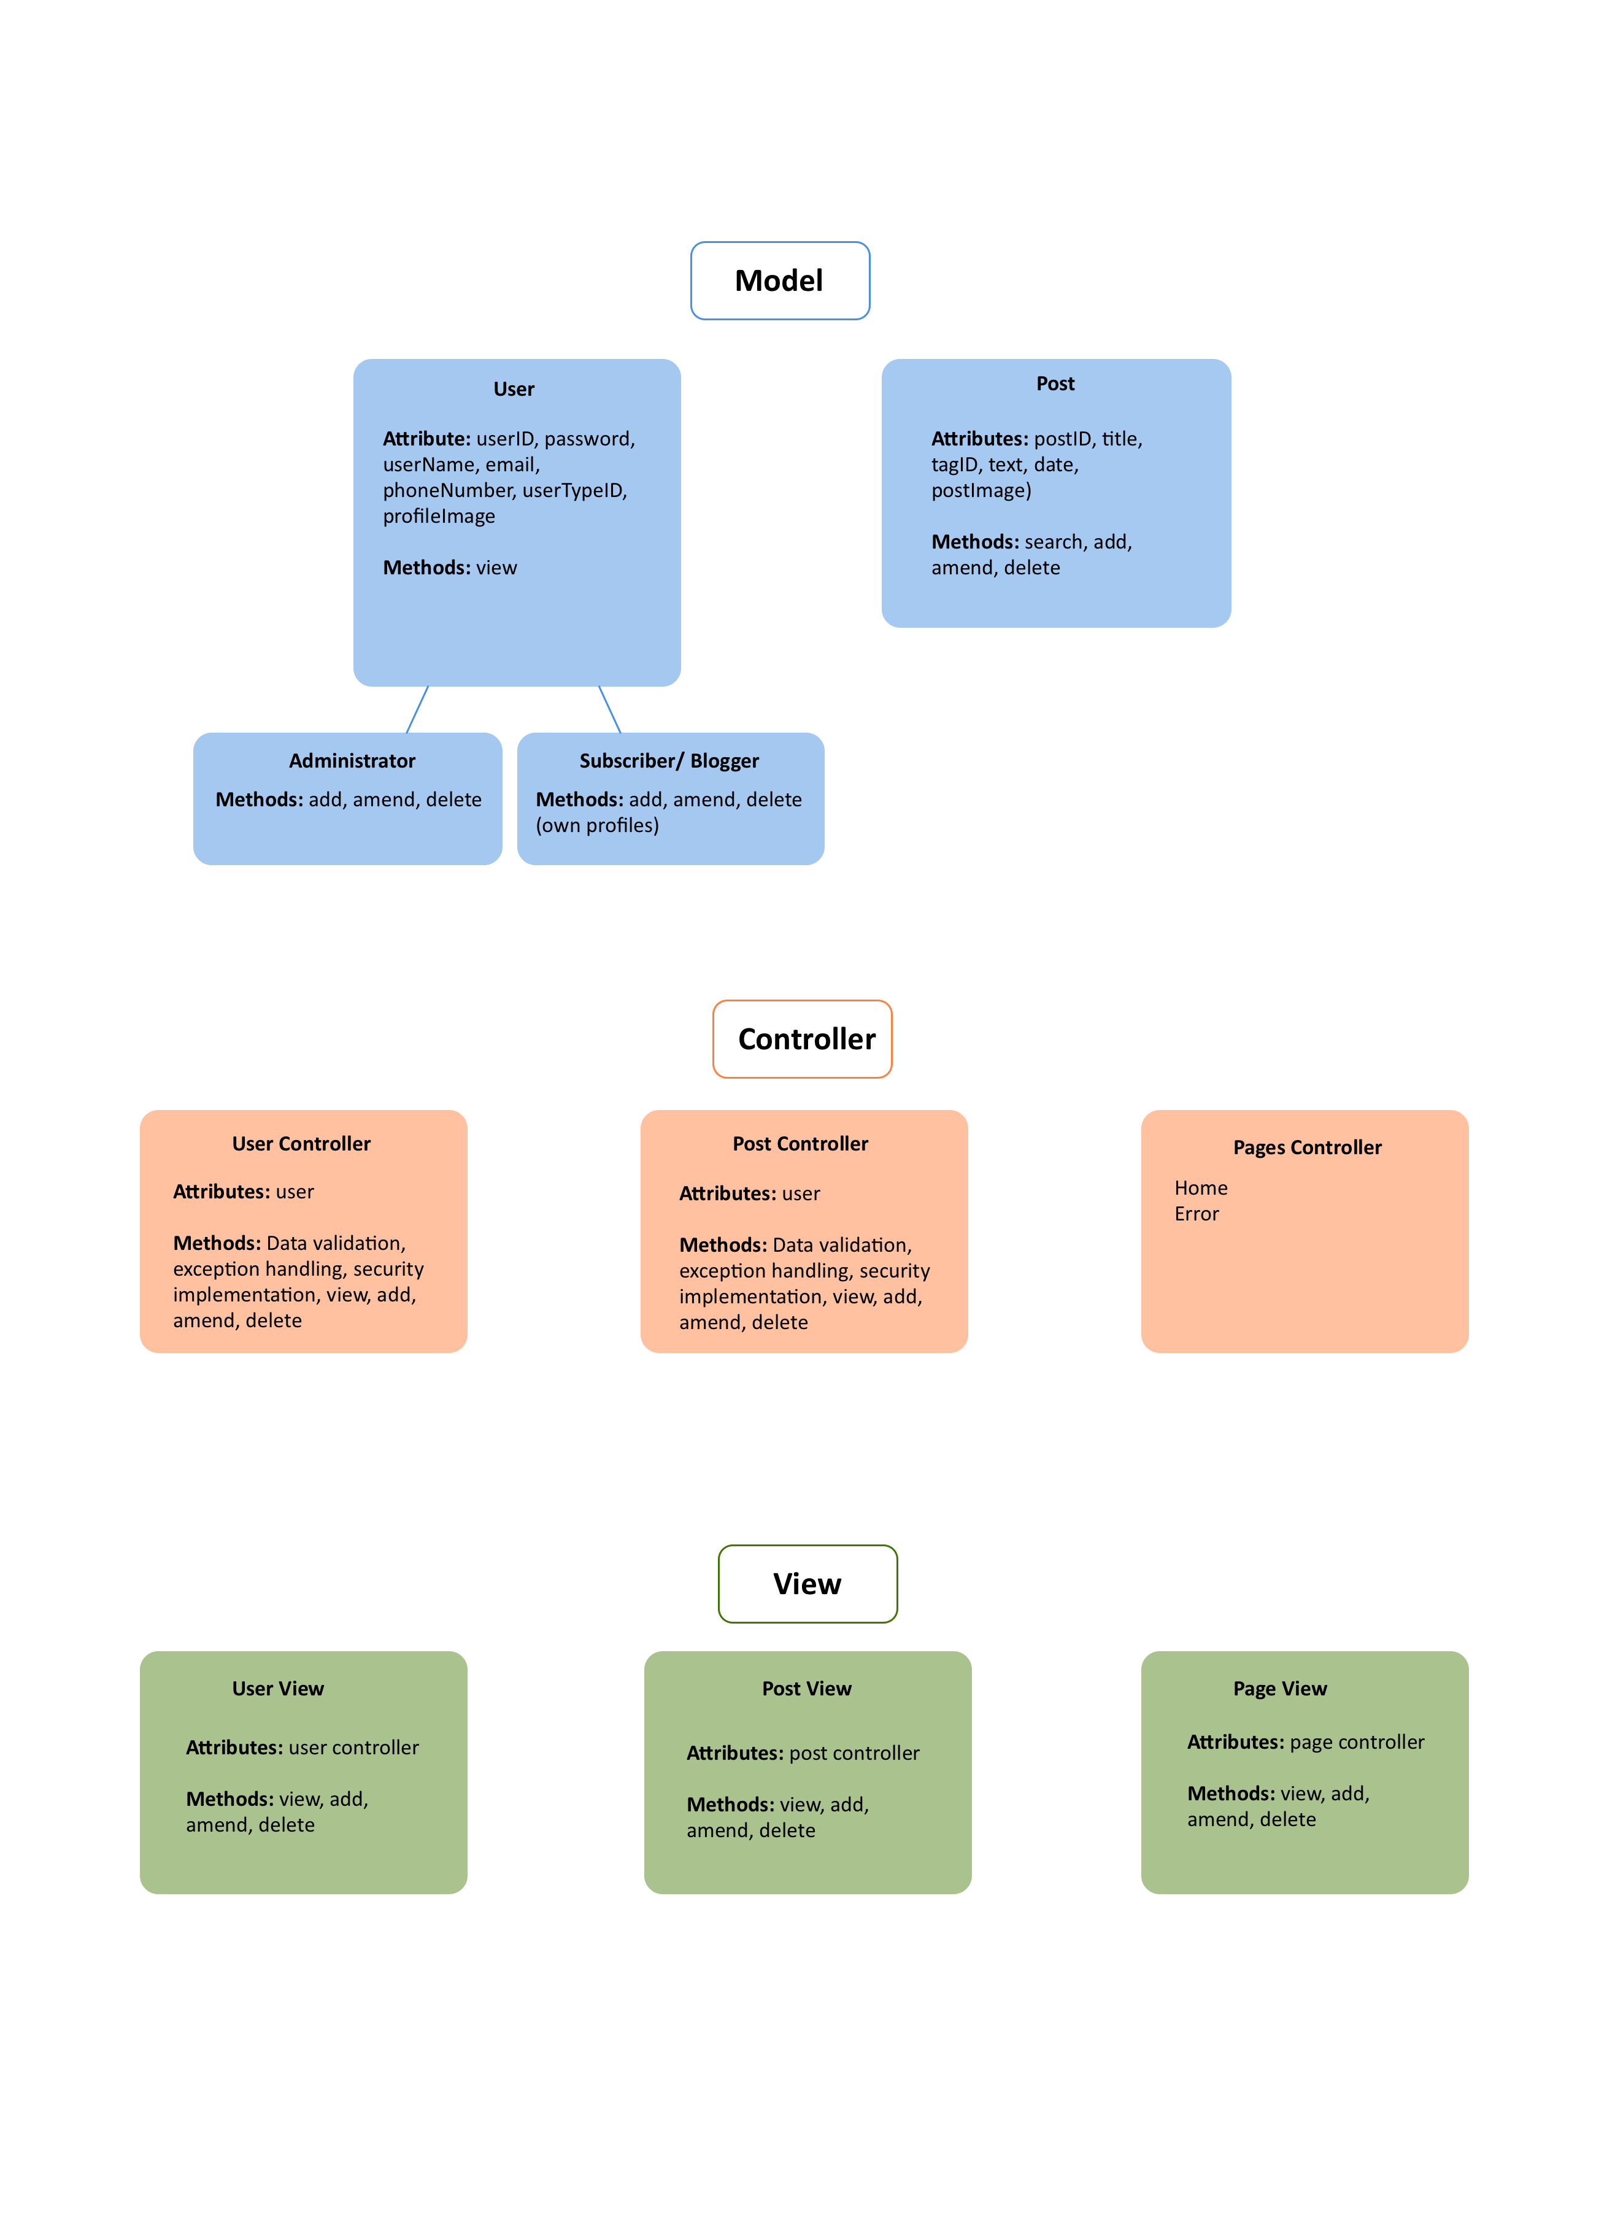
MVC model
Notes:
MVC Model used to develop database design and wireframes.

Slide 4
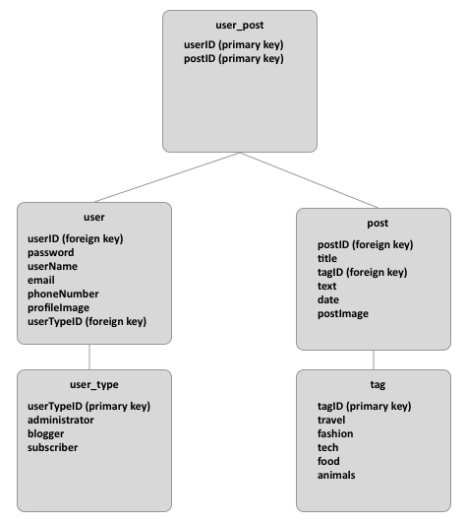
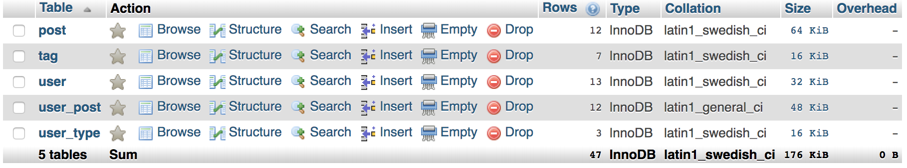
Database Design
Designed database – with post / user tables and normalisation included.
MySQL default functionalities:
Unique keys
Date - timestamp

Slide 5
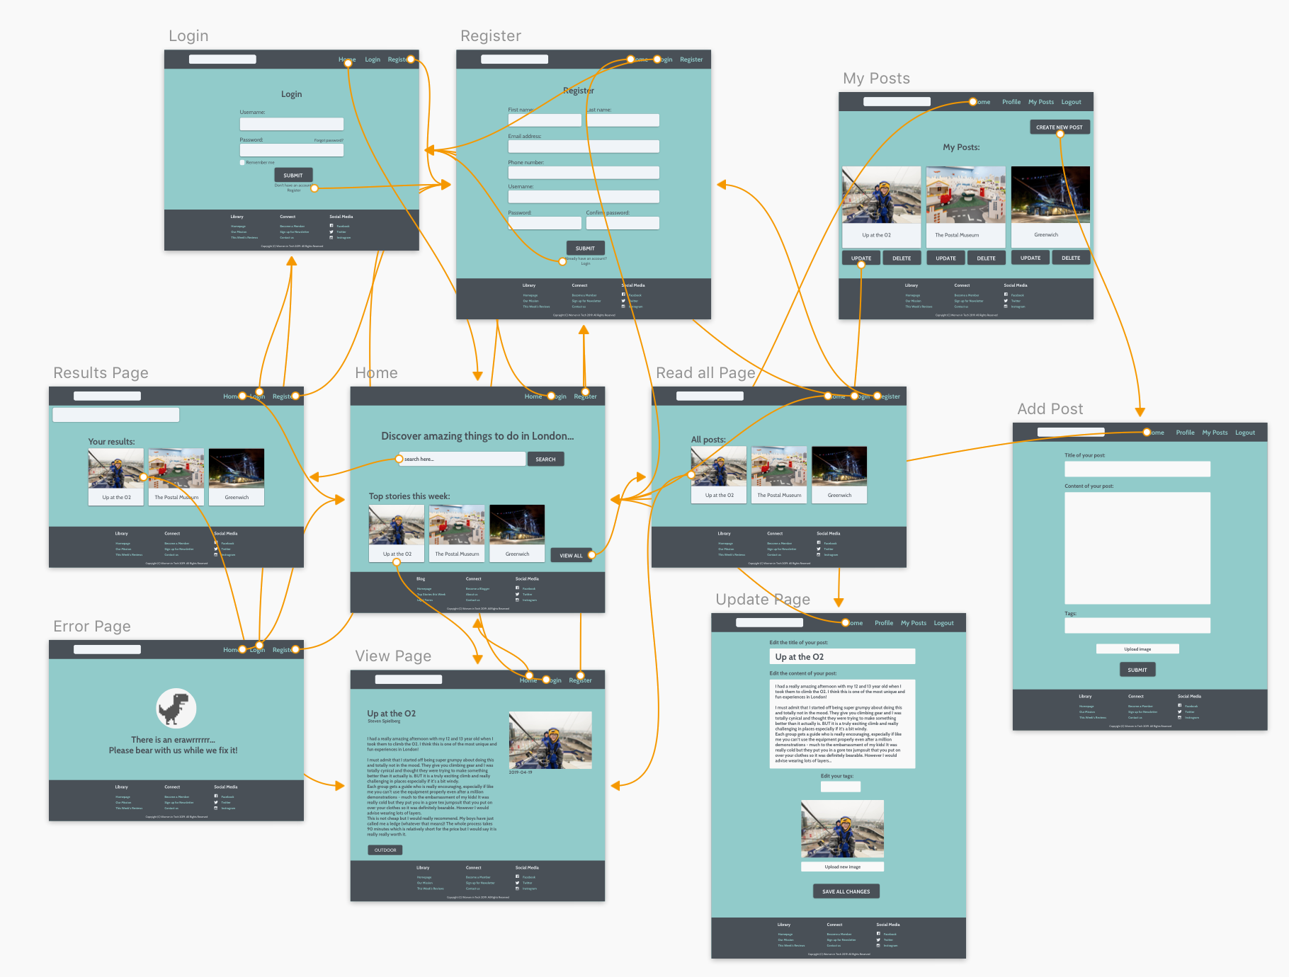
Wireframe

Slide 6
Frolicking through our Website
Designed website based on wireframe and added the following functionalities:
Registration form
Dynamic navigation bar
Log in / Log out
Sharing posts
My Posts
My Profile
Search function
Top stories
Contact us
Responsive layout
Notes:
Registration form – add new users, password confirmation
Dynamic navigation bar
Log in / Log out (sessions)
Sharing posts (Reddit, Twitter, Facebook)
My Posts (update, delete, create, viewAll, read)
My Profile (amend user information)
Search function (%like%)
Top stories – choses three random posts everytime page refreshes

Slide 7
No Frolicking
Organisation
Weekend / weekday Hangouts
Daily standups
Final Hangout
Agile / Scrum – designated scrum master
Tools we used
Trello
Whatsapp
GitHub

